Slide 1
Chapter 10 Modern Atomic Theory
Ch. 10.1-10.3
Notes

Slide 2
10.1: Rutherford’s Atom
Review
Rutherford’s atomic structure

Slide 3
10.1: Rutherford’s Atom
Holes?
What are the electrons doing?

Slide 4
10.2: Electromagnetic Radiation
Electromagnetic Radiation
Energy being transmitted by light
Wavelength
Distance between two consecutive wave peaks

Slide 5
10.2: Electromagnetic Radiation
Frequency
How many wave peaks pass a certain point per given time period
Speed
How fast a given wave travels

Slide 6
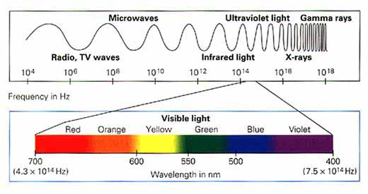
10.2: Electromagnetic Radiation

Slide 7
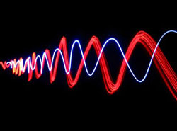
10.2: Electromagnetic Radiation
Dual Nature of Light
Light has two characteristics
Light as a wave
Light as particles (photons)

Slide 8
10.2: Electromagnetic Radiation
So which is it? Light or Wave?

Slide 9
10.3: Emission of Energy by Atoms
Light and color

Slide 10
10.3: Emission of Energy by Atoms
Elements and color

Slide 11
10.1: Rutherford’s Atom
Review
The atom is made up of a small, positive core called the nucleus and negative electrons that move around the nucleus.
This nuclear model of the atom was introduced by Earnest Rutherford due to his famous gold foil experiment.
The nucleus is made up of positive protons and neutral neutrons.
The nucleus is very small compared to the size of the atom. The orbiting electrons account for most of the space taken up by the atom.

Slide 12
10.1: Rutherford’s Atom
Holes?
A major question left unanswered by Rutherford’s experiment was “What are the electrons doing?”
How are they arranged?
How do they move?
Why don’t the electrons collapse into the nucleus?

Slide 13
10.2: Electromagnetic Radiation
When you hold your hand close to a light bulb, it feels warm. Same with fire and sun.
Electromagnetic Radiation
Energy being transmitted by light
How do different types of E.R. differ from one another?

Slide 14
10.2: Electromagnetic Radiation
A wave is characterized by 3 properties:
Wavelength, frequency and speed
Wavelength
Distance between two consecutive wave peaks
Frequency
How many wave peaks pass a certain point per given time period
Speed
How fast a given wave travels

Slide 15
10.2: Electromagnetic Radiation
Microwaves
High or low frequency?
Long or short wavelength?
How do they work?
Gamma Rays
High or low frequency?
Long or short wavelength?
Why so damaging?

Slide 16
10.2: Electromagnetic Radiation
Dual Nature of Light
Light has two characteristics
Light as a wave
Light as particles (photons-packets of light)

Slide 17
10.2: Electromagnetic Radiation
So which is it?
It’s both! Light has both wave and particle-like characteristics.
In general, the longer the wavelength of light, the lower the energy of the light particles (photons).

Slide 18
10.3: Emission of Energy by Atoms
When atoms experience an increase in energy, they absorb that energy and become “excited”.
An increase in energy means a decrease in…STABILITY! So it cannot remain excited for long.
When an atom falls back down from it’s excited state, it emits a photon of light, or energy packet.
Human eyes associate this photon emission with some color.

Slide 19
10.3: Emission of Energy by Atoms
Different atoms can carry different amounts of energy and have varying wavelengths. Therefore, atoms of different elements will carry different amounts of energy.
When different elements are introduced to an increase in energy, they emit different colors of light.
Lab on Monday!

